Slide 1
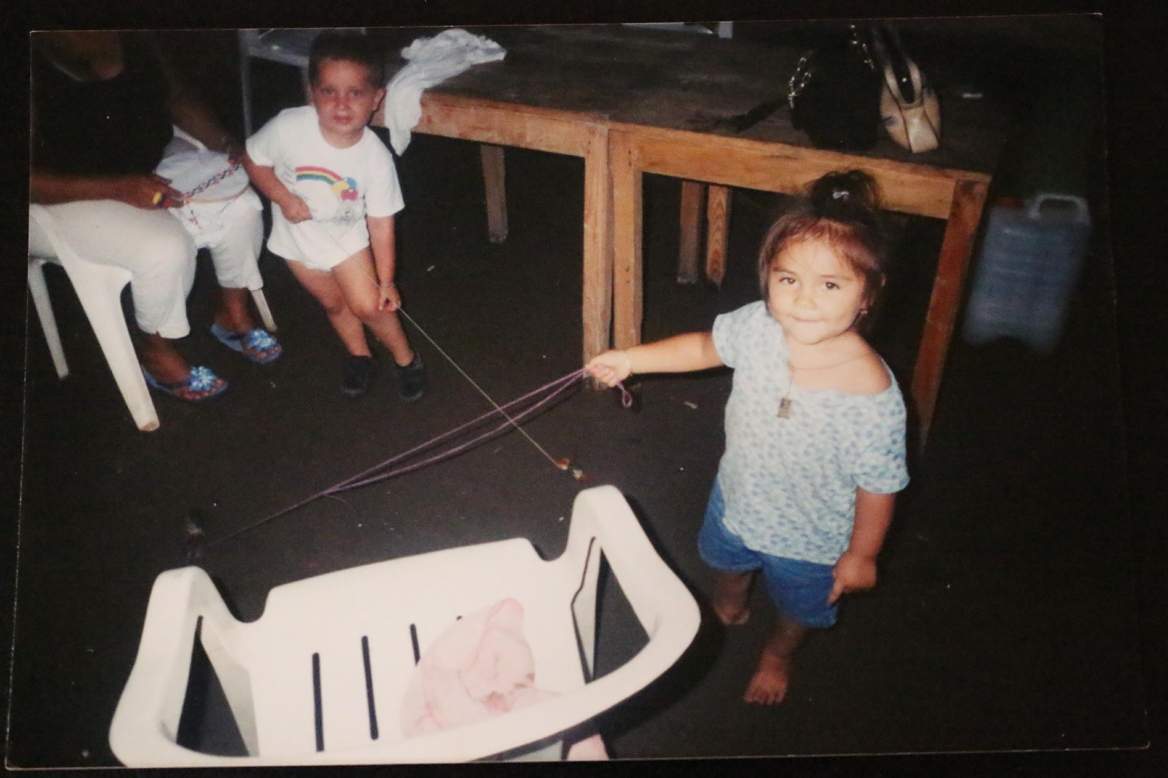
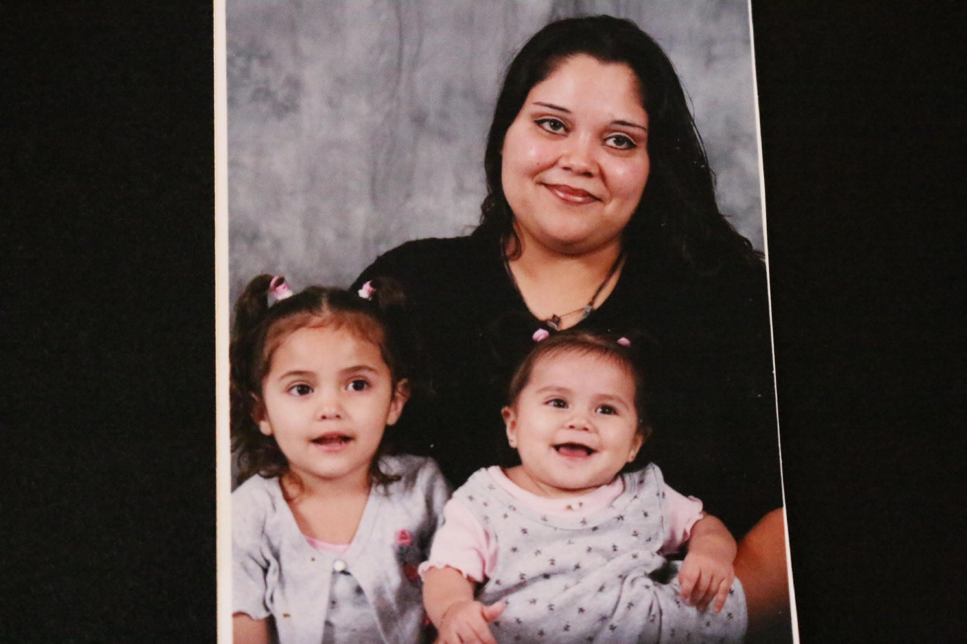
Natalie Frias
Lindsay High School
Class of 2017

Slide 2
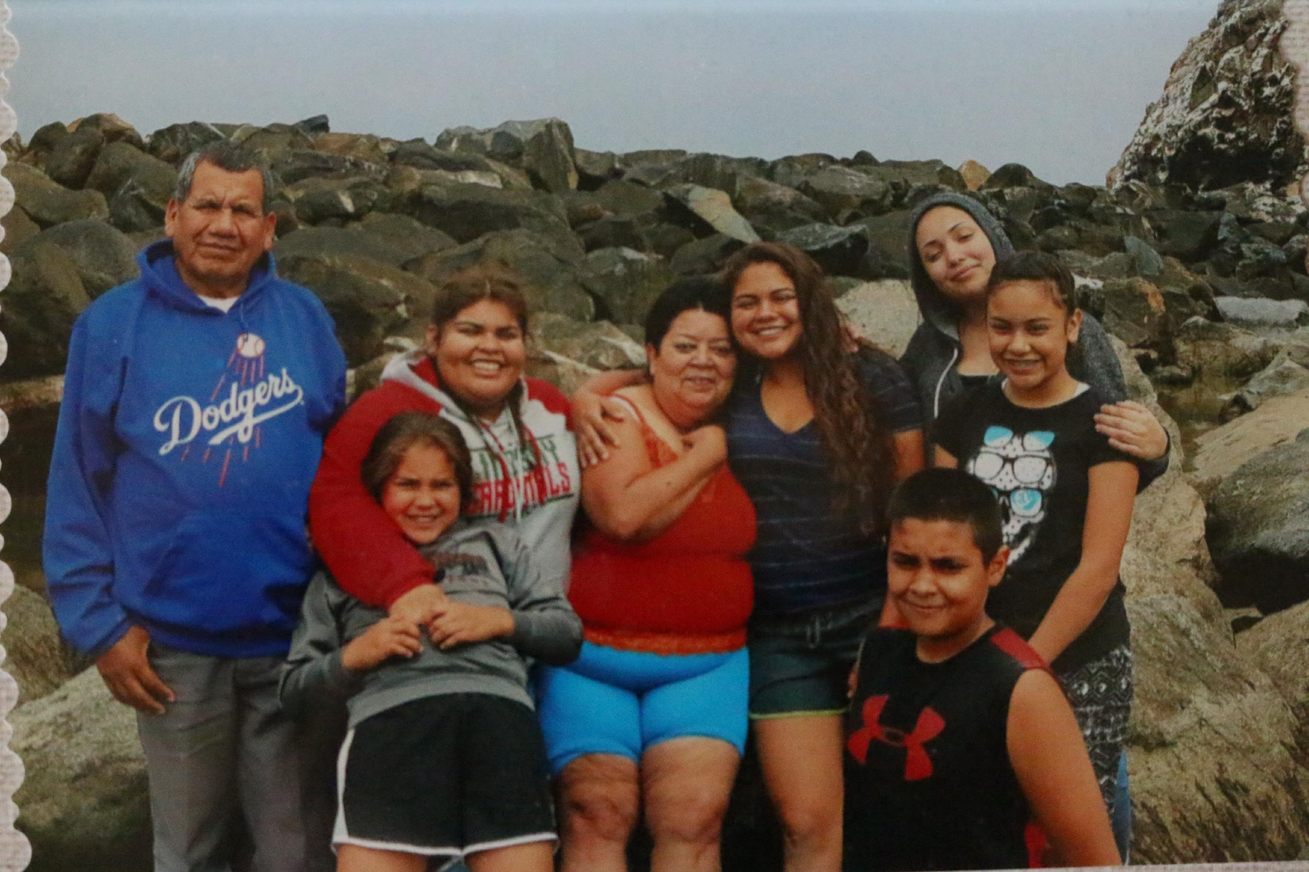
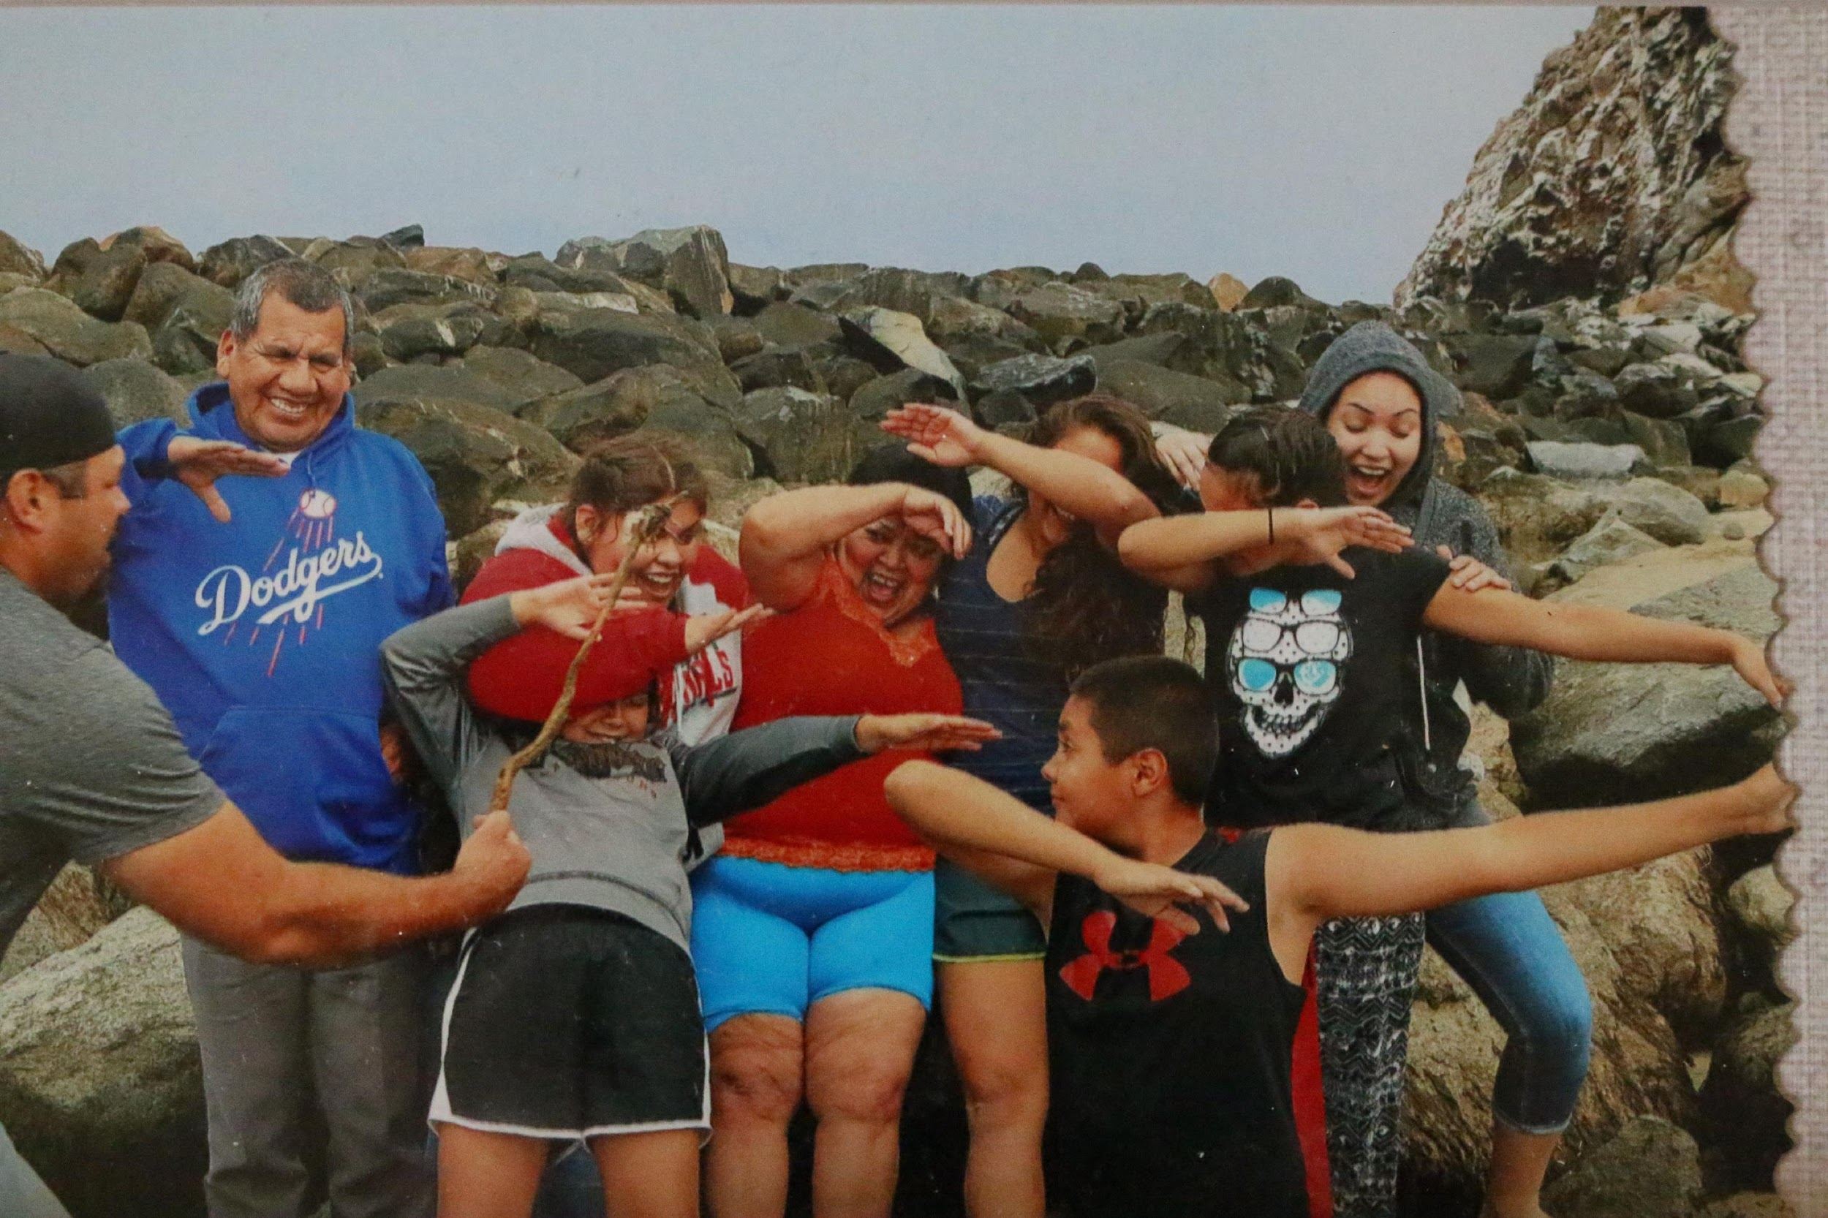
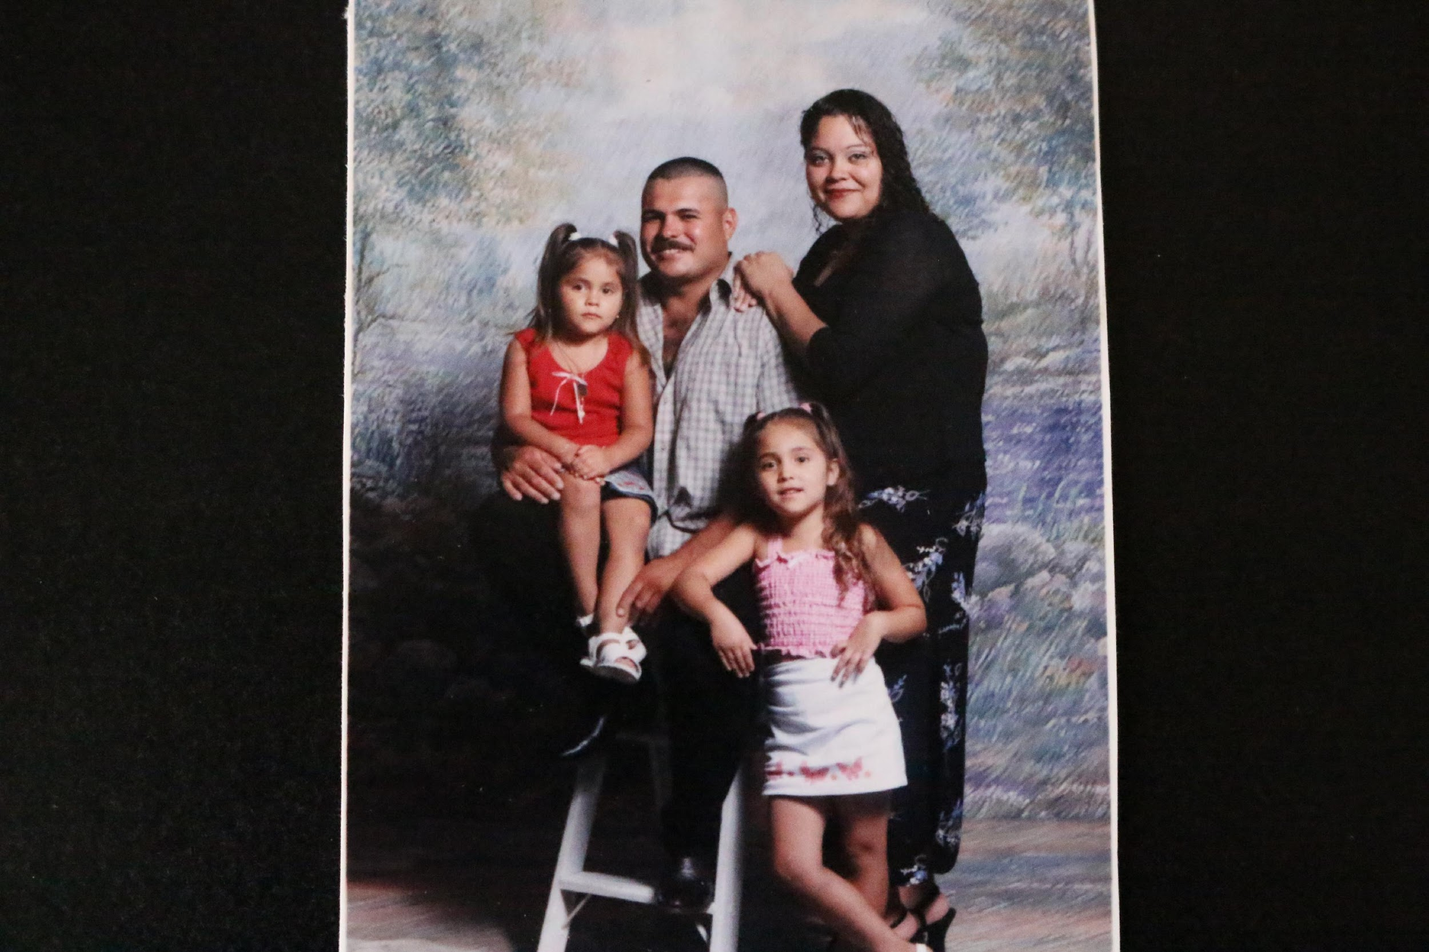
About Me
Born March 26 1999.
Born and raised in Lindsay California
Growing up I loved being outside
Games with my cousin Tony and my sisters
Sports like softball
Events with my Family
All of which had a huge impact on my life

Slide 3
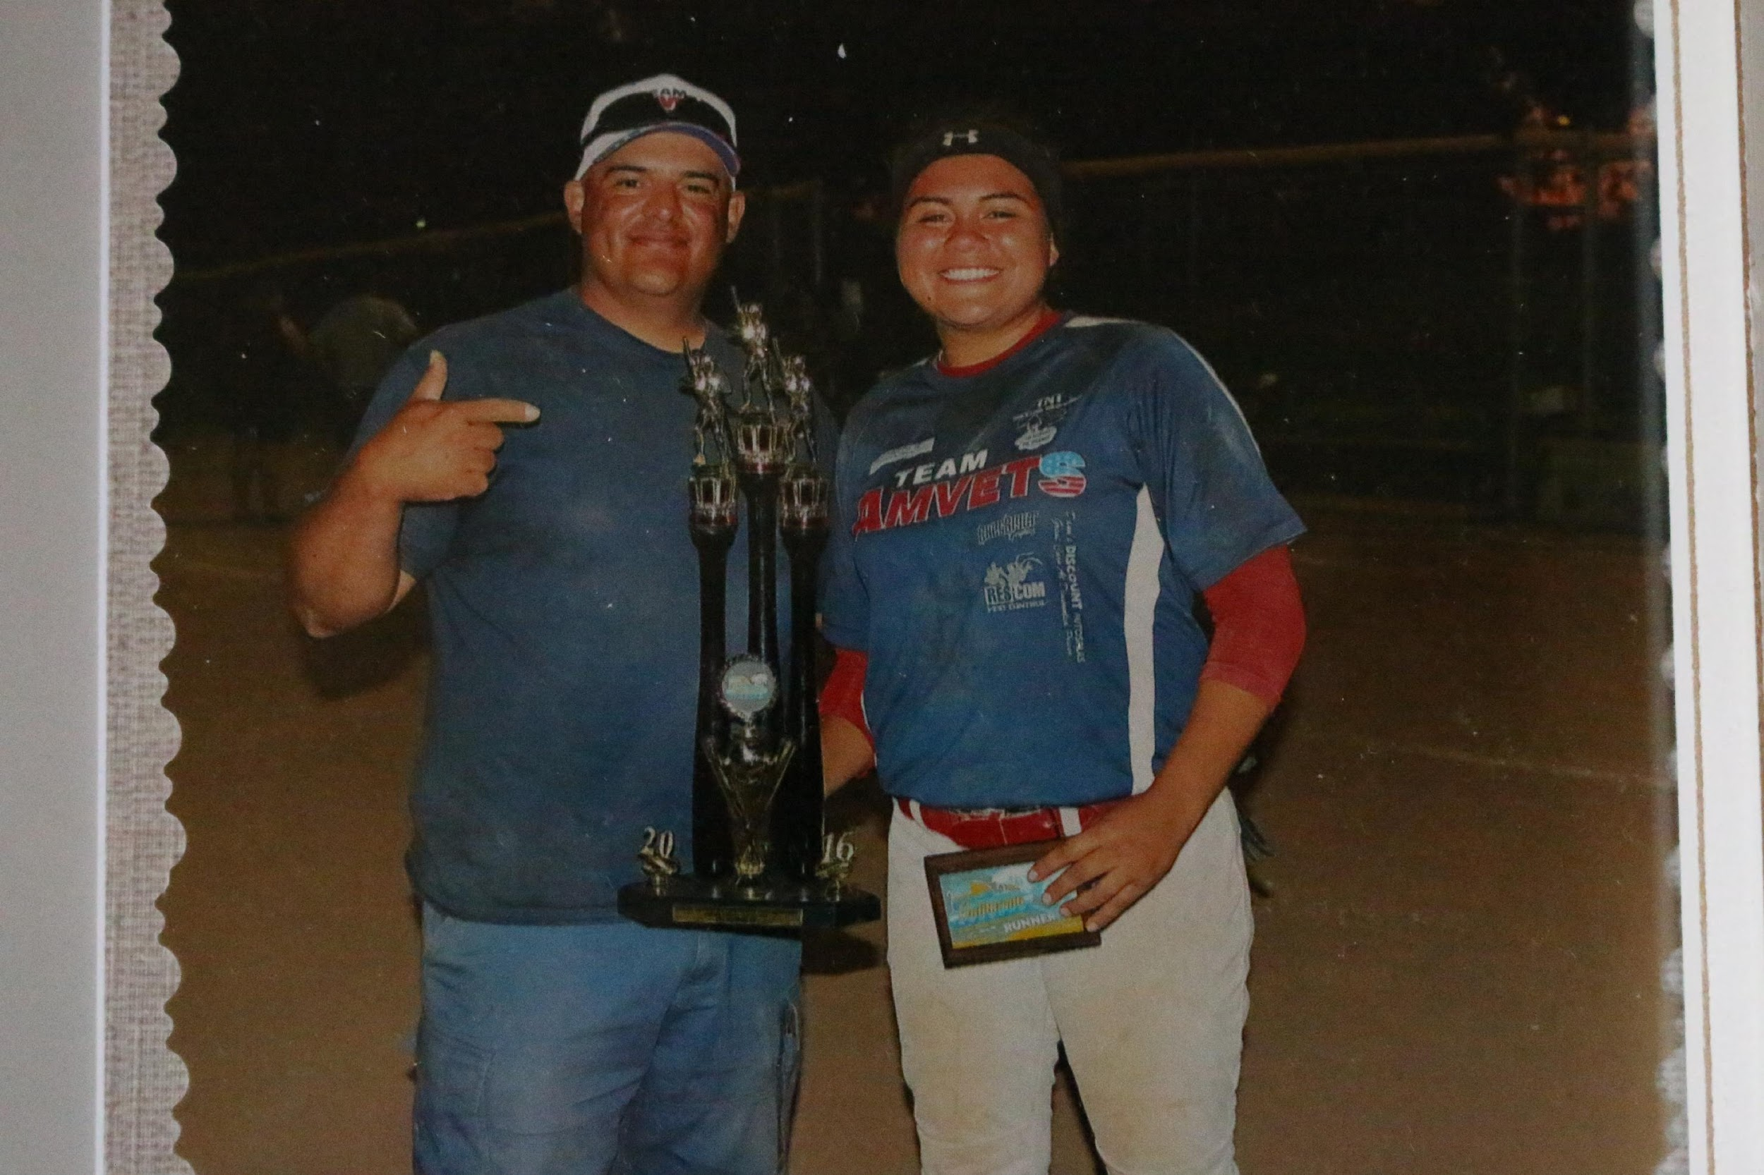
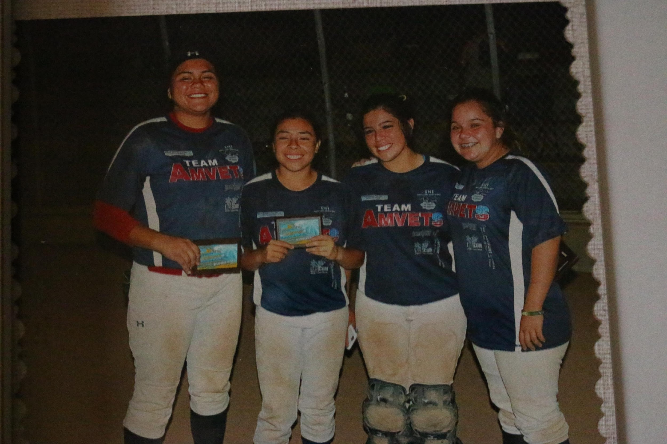
Softball
Growing up I played a lot of sports but softball was my favorite
Joined first travel team when I was 11
Coach Adrian taught me everything I know
Played softball for many different teams all coached by coach Adrian

Slide 4
High School Experience
In high school I experienced some trouble adjusting
Some challenging classes were AVID, Core Classes (Econ., Algebra 2), and Psychology.
I struggled with procrastination, I am a HUGE procrastinator
The two most important things I learned in High School:
I learned to make the most of what I have
And to take accountability and responsibility of everything I do

Slide 5
Job Shadow
In the future I want to major in Psychology, minor in Criminology, and become a Correctional Officer
I would like to council the prisoners and help them Rehabilitate themselves
Couldn’t go to a prison for my job shadow
I went to the Lindsay Tulare Works Office
Shadowed Brianna Ceja
Couldn’t see her at work first hand due to privacy issues
Learned Organizational Skills and How to use all the resources I have at hand

Slide 6
Pathway
I chose spanish as my pathway
I am a fluent english and spanish speaker
Spanish will help me communicate better with clients and/or people I am counseling

Slide 7
Post-High School Plans
Plan on Attending COS for 2 years
Transfer to Fresno State
Major in Psychology
Become a Correctional Officer
Council Prisoners

Slide 8
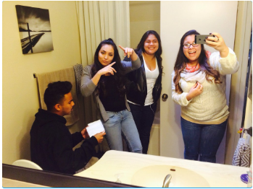
Any Questions?

